Slide 1
Group work task 3 reminder

Slide 2
Research Communication Skills
Designing Academic Posters

Slide 3
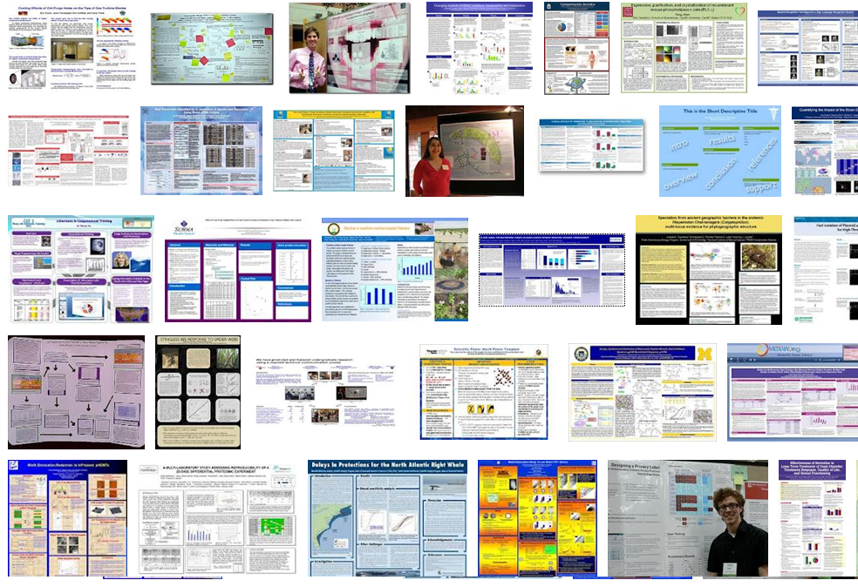

Slide 4
Intended Learning Outcomes
By the end of this lesson you will be able to:
  develop academic poster
  present the academic poster during a conference poster session
  evaluate academic posters

Slide 5
Academic poster
Scientific poster
Research poster
……..

Slide 6
Academic Poster
A form of Scientific Expression
Summary of Research (5 – 10 minutes)
Visually augmented discussion/interaction
At conferences viewers come to you (or you can invite)

Slide 7
Why Submit a Poster?
An opportunity to effectively share research results and engage in scientific dialog with colleagues
Feedback received can help in refining your research and preparing it for publication

Slide 8
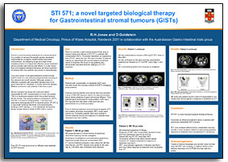


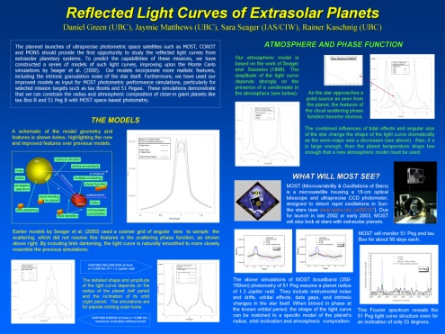
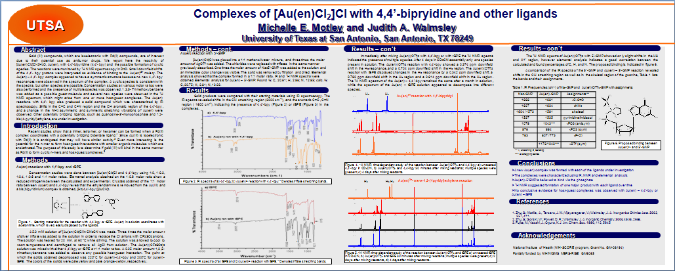
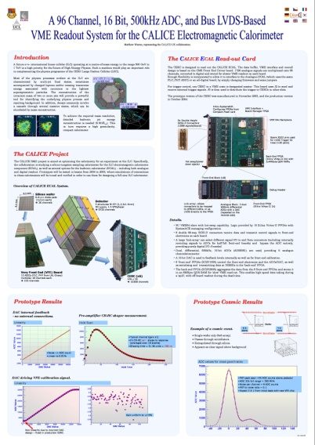
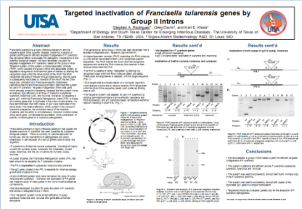
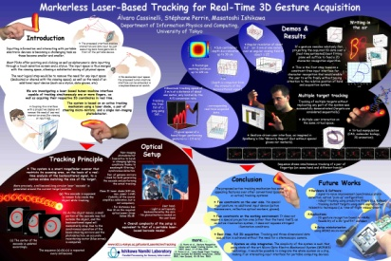
Which is a “Correct” Poster?

Slide 9
Content and format requirements are not as strict as for the research paper

Slide 10
Appearance
Use very large font for title (~90 pt)
Fairly large for names (~72 pt)
Use at least 20 (24 better) pt text for body text
  Read ~1-1.5 m away
  Figure lettering must also be this large!!!!

Slide 11
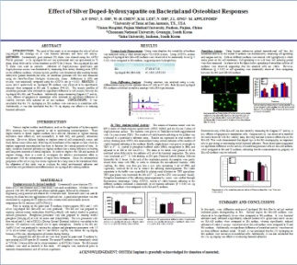
Visually Appealing

Slide 12
Designing Your Poster:
Make it clear and easy to read!
  Large block fonts
  Contrasting colors
  “White” spaces, margins
  Bold titles, sub-titles
  Short paragraphs
  Bulleted points
Can you read this?
How about this?
Is this better?
Make it easy to read!

Slide 13
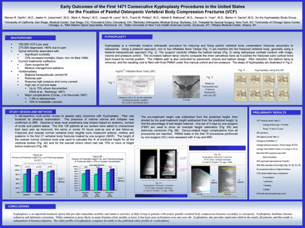
Designing Your Poster:
Create logical flow!
  Top left to bottom right
  Set off each section
    Bold sub-titles
    Different colors
  Direct reader’s eye
    Arrows
    Highlights

Slide 14
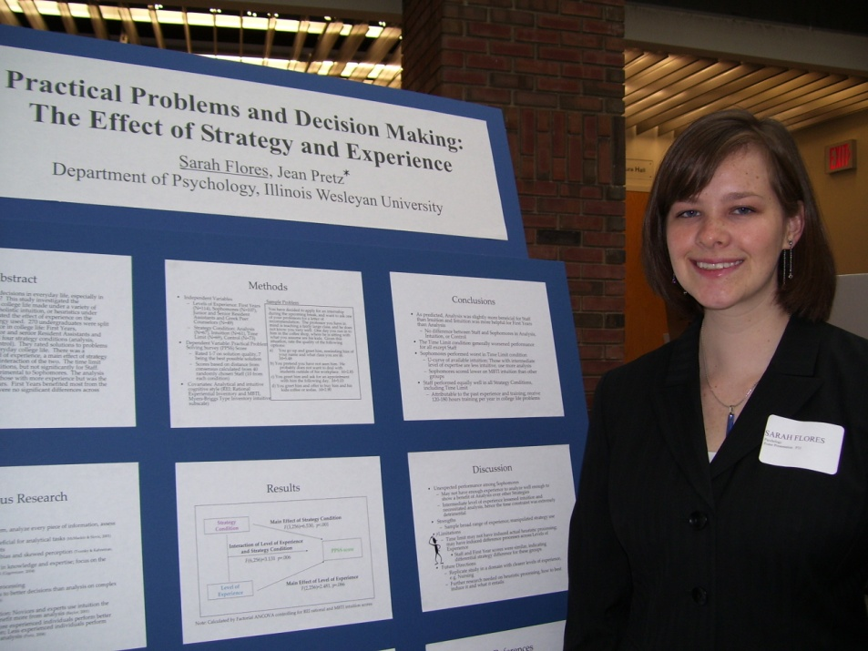
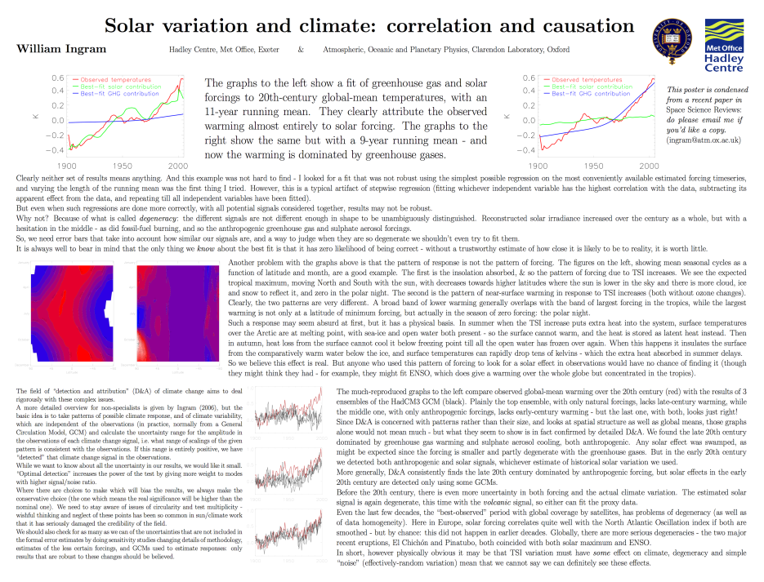
Designing Your Poster:
Make it interesting!
  A picture is worth a thousand words!
  Graphs and tables make data easy to interpret

Slide 15
Printing Considerations
Leave a white border (for push-pins)
Remember to spell check
Check every inch and check again
Ask a colleague to proof the poster

Slide 16
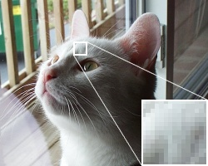
Pictures
Use standard formats
  .jpg, .gif, .tiff, .tif, .bmp
Watch resolution of photos
  72 dpi vs 300
    72 dpi will look pixelated on a poster
    230 dpi prints like a photo
Insert high dpi photos
Make them relatively large
Stretch to correct size

Slide 17
Contents of a Research Poster:
Title & Authors
Abstract
Research Objectives
Materials & Methods
Results/Data
Conclusions/Discussion
Future Directions
Literature Cited
Acknowledgements

Slide 18
Contents of a Research Poster:
Title & Authors
Abstract
Research Objectives
Materials & Methods
Results/Data
Conclusions/Discussion
Future Directions
Literature Cited
Acknowledgements
The same as in the research paper but not “copy and paste”
  Summarize
  Short text descriptions
  Represent information visually
The requirements are not that strict as a research paper
Some sections may be omitted/combined – depending on the conference requirements and your preference
  Abstract
  Literature cited
  Acknowledgements

Slide 19
Title & Authors:
Title:
  Short, Succinct, Specific
Authors:
  Discuss with mentor, collaborators to determine appropriate inclusions and name order
  Include institutional affiliations
Formatting:
Centered across top
Large, bold font
Different sizes, colors to set off
Can highlight presenter’s name

Slide 20

Examples of Title/Author Lines:
Mast Cells in Oral Lichen Planus:
Comparison of Two Methods for Histologic Detection
J. Springsteen, N.L. Rhodus, S. Kaimal, & S.L. Myers
University of Minnesota School of Dentistry, Minneapolis, MN
University of Minnesota
School of Dentistry

Slide 21
Abstract:
Brief summary of your research:
  Background information
  Objectives and/or hypotheses
  Abridged materials & methods
  Overview of findings
Use text submitted for poster registration!
Formatting:
Upper left corner
Smaller font than rest of poster
Can italicize text

Slide 22
Background:
Introduce reader to your subject:
  Why is the issue important?
  What has other research shown?
  Basic facts/information about subject
Formatting:
Standard font size and style as rest of poster text
Brief prose, don’t bullet
Images are helpful

Slide 23
Research Objectives:
Clearly state why you did the project:
  Specific research question(s)
“Aims”, “Goals”, “Hypotheses”, etc.
Keep these short and succinct
Formatting:
Standard font size and style as rest of poster text
Bullets or numbered sentences

Slide 24
Materials & Methods:
Exactly what you did and how you did it.
  Tables and diagrams are helpful and visually engaging
Formatting:
Standard font size and style as rest of poster text
Images, diagrams
Sub-titles

Slide 25
Results:
Present your data:
  Tables & graphs when possible - don’t hide numbers in text
Formatting:
Standard font size and style as rest of poster text
Use tables & figures; limit prose
Sub-titles

Slide 26
Conclusions:
Explain your data:
  Address your specific research objectives
  Summarize statistically significant data
  Report unexpected or abnormal findings
  Discuss problems encountered or suspected
Formatting:
Standard font size and style as rest of poster text
Images, diagrams
Sub-titles

Slide 27
Future Directions:
Outline future research:
  Improvements to study design
  Ways to address unexpected findings
  New objectives developed from this project
Formatting:
Standard font size and style as rest of poster text
Bulleted lines, 1.5 - 2.0 spacing

Slide 28
Literature Cited:
Format as directed by poster guidelines, if specified
-or-
Use a standard, consistent format as observed in current scientific journals
  Numerical endnotes
  Parenthetical author’s name and year
Formatting:
Numbered as listed in text, or
Alphabetical, chronological
1.5 - 2.0 line spacing
Don’t use bullets

Slide 29
Acknowledgements:
Thank your supporters -- Important!
  Who funded your project?
  Did you receive any donations?
  Is your research part of a larger project?
  Did someone else do your data collection? Analysis? Writing? Design?
Formatting:
Lower right corner
Small, italicized font
Multiple, separated lines for multiple acknowledgements

Slide 30
Creating the Poster

Slide 31
Software
Actual layout:
  Powerpoint (one big slide)
  Pagemaker
  Canvas
  Illustrator
  Quark
  Postergenius: http://www.postergenius.com/cms/index.php
  Ask print shop about requirements
  Print directly or convert to pdf
Images (compatible with printer driver!)
  Photoshop
  MS Photo editor
Tables/Graphs
  Directly from Office (Excel or Word)

Slide 32
Look at Sample Posters and Evaluate…

Slide 33
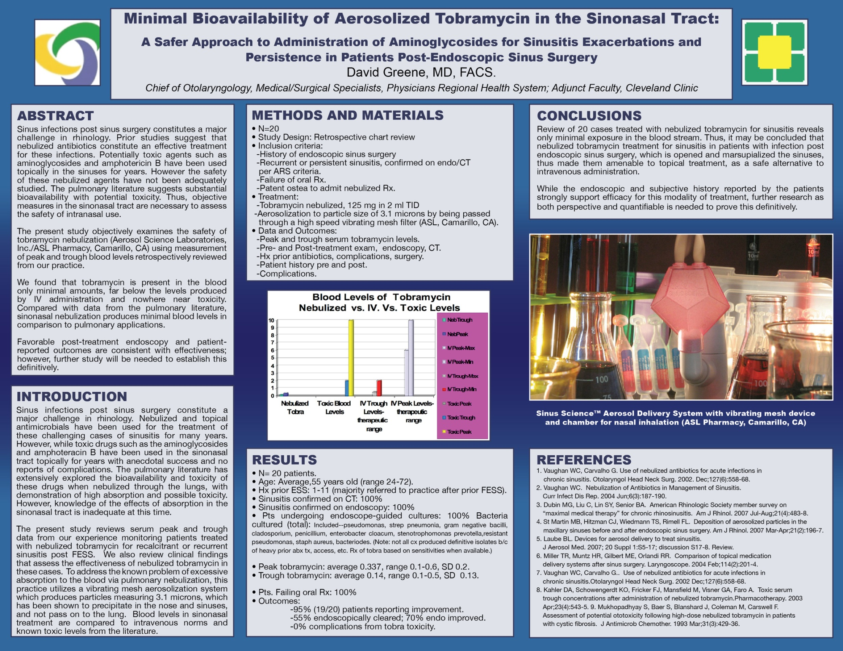

Slide 34
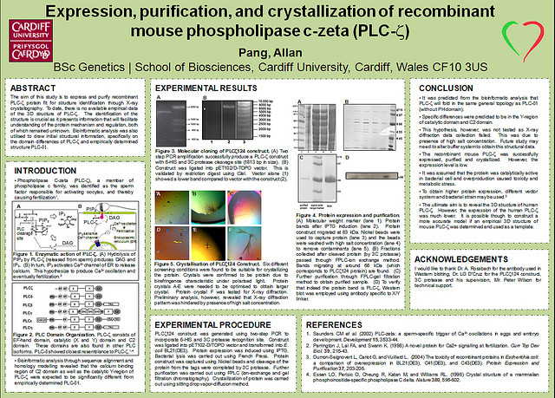
Analyze

Slide 35
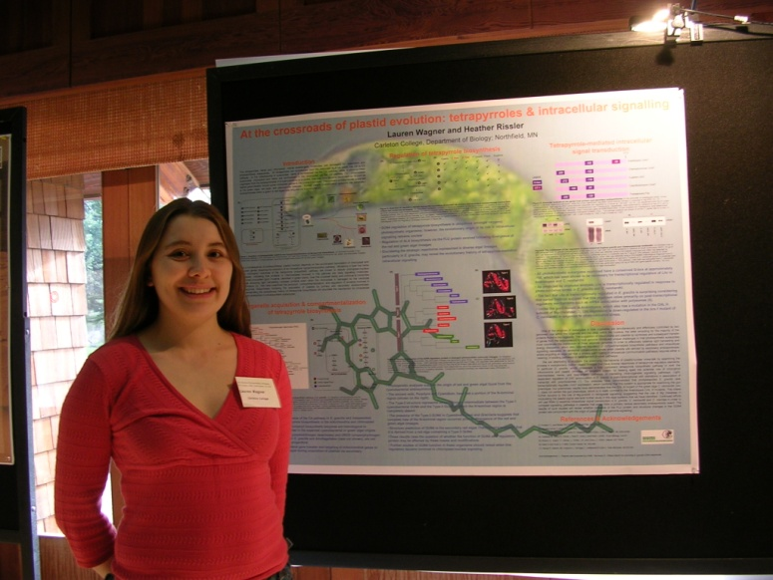
Mechanics of Presentation

Slide 36
Practice
MAKE SURE TO PRACTICE!
Develop 2 and 5 minute presentation
Use the poster as a visual aid
  Refrain from reading it
Know first sentence
What to say for each figure
Transitions between figures
What to point at for each figure

Slide 37
Practice
Practice with group mates and laymen
Run through ENTIRE poster
Be friendly
Don’t sound like you’ve memorized
Be excited about your work
Remember to refer to your poster!
Be flexible - they may interrupt with questions
Pause long enough for them look at figure
Know what questions may be asked….
  Can practice them

Slide 38
Posture/Movement
Be relaxed
Avoid excess movement
  Don’t fidget/twist fingers
  Don’t fiddle with rings, etc.
Face audience (glance at poster)
Stand on both feet
Don’t lean
Arms relaxed with movement
  Avoid crossed (closed off)

Slide 39

Positioning
Recommended – on side where poster begins.
Gesture with left hand
Some want a pointer (physical)
  Laser pointer?
  Recommend hand
Don’t turn from audience, though…body open.

Slide 40
First Contact
Stand to the left of poster (where audience starts reading)
Take initiative
Smile, but stay near poster
If they come closer
  Say, “Hello” and shake hands
  Introduce yourself “My name is… I am a student at …”
  Ask if they’d like “you to walk them through your poster”
    YES? Then GO! → “This is work that I performed this semester in the Professional Research English class.”
  (Optional) Ask if they are familiar with this field of research
    No- More introduction, careful with acronyms
    Yes- Can go more quickly through intro

Slide 41
Flow of a presentation
Start with Intro that will catch them
  No pointing if you have no figure!
Move to Methods
  Briefly summarize
Move to Results
  Longest section
  Walk thru all figures
Transition to Conclusions
Say Conclusions
Acknowledgements (optional)
Any Questions?

Slide 42
Have Strong Transitions
Know opening sentence
Between each Section
Between internal and closing
Develop strong closing
  Can I tell you anything else about project?
  I’ll be happy to answer questions at this time.

Slide 43
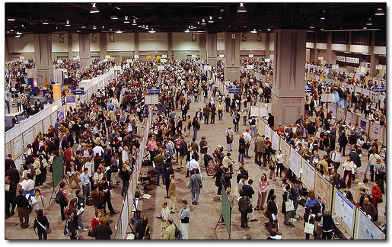
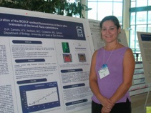
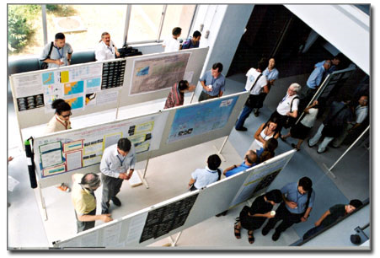
Set up conditions vary
May be hard to hear
Must speak up!!!
PHOTOS BY COLIN PURRINGTON
http://www.swarthmore.edu/NatSci/cpurrin1/posteradvice.htm

Slide 44
Coming Home Again
Keep promises that you’ve made
Drop emails to other researchers whom you’ve met
Hang poster outside of lab

Slide 45
Reference Materials

Slide 46
Poster Templates…
Sample posters and templates can be seen online
  find templates that appeal to you

Slide 47
Poster Templates

Slide 48


Poster title goes here, containing strictly
only the essential number of words...
Author’s Name/s Goes Here, Author’s Name/s Goes Here, Author’s Name/s Goes Here
Address/es Goes Here, Address/es Goes Here, Address/es Goes Here
Introduction
First…
Check with conference organisers on their specifications of size and orientation, before you start your poster eg. maximum poster size; landscape, portrait or square.
The page size of this poster template is A0 (84x119cm), landscape (horizontal) format. Do not change this page size, MIU can scale-to-fit a smaller or larger size, when printing. If you need a different shape start with either a portrait (vertical) or a square poster template.
Bear in mind you do not need to fill up the whole space allocated by some conference organisers (eg. 8ftx4ft in the USA). Do not make your poster bigger than necessary just to fill that given size.
Method
Tips for making a successful poster…
Re-write your paper into poster format ie.
Simplify everything, avoid data overkill.
Headings of more than 6 words should be in upper and lower case, not all capitals.
Never do whole sentences in capitals or underline to stress your point, use bold characters instead.
When laying out your poster leave breathing space around you text. Don’t overcrowd your poster.
Try using photographs or coloured graphs. Avoid long numerical tables.
Spell check and get someone else to proof-read.
Results
Importing / inserting files…
Images such as photographs, graphs, diagrams, logos, etc, can be added to the poster.
To insert scanned images into your poster, go through the menus as follows: Insert / Picture / From File… then find the file on your computer, select it, and press OK.
The best type of image files to insert are JPEG or TIFF, JPEG is the preferred format.
Be aware of the image size you are importing. The average colour photo (13 x 18cm at 180dpi) would be about 3Mb (1Mb for B/W greyscale). Call MIU if unsure.
Do not use images from the web.
Notes about graphs…
For simple graphs use MS Excel, or do the graph directly in PowerPoint.
Graphs done in a scientific graphing programs (eg. Sigma Plot, Prism, SPSS, Statistica) should be saved as JPEG or TIFF if possible. For more information see MIU.
Printing and Laminating…
Once you have completed your poster, bring it down to MIU for printing. We will produce a A3 size draft print for you to check and proof read. The final poster will then be printed and laminated.
Note: Do not leave your poster until the last minute. Allow at least 5 working days before you need to use it.
Simply highlight this text and replace.
Cost…
For poster-printing and laminating charges contact to MIU
Captions to be set in Times or Times New Roman or equivalent, italic, between 18 and 24 points.
Left aligned if it refers to a figure on its left. Caption starts right at the top edge of the picture (graph or photo).
Conclusion
For more information on:
Poster Design, Scanning and Digital Photography,
and Image / file size.
Contact:
Medical Illustration Unit
Prince of Wales Hospital
Ph: 9382 2800
Email: miunsw@unsw.edu.au
Web: http://miu.med.unsw.edu.au
Aim
How to use this poster template…
Simply highlight this text and replace it by typing in your own text, or copy and paste your text from a MS Word document or a PowerPoint slide presentation.
The body text / font size should be between 24 and 32 points. Arial, Helvetica or equivalent.
Keep body text left-aligned, do not justify text.
The colour of the text, title and poster background can be changed to the colour of your choice.
Captions to be set in Times or Times New Roman or equivalent, italic, between 18 and 24 points. Right aligned if it refers to a figure on its right. Caption starts right at the top edge of the picture (graph or photo).
Captions to be set in Times or Times New Roman or equivalent, italic, between 18 and 24 points.
Left aligned if it refers to a figure on its left. Caption starts right at the top edge of the picture (graph or photo).
Acknowledgements
Just highlight this text and replace with your own text. Replace this with your text.
Captions to be set in Times or Times New Roman or equivalent, italic, 18 to 24 points, to the length of the column in case a figure takes more than 2/3 of column width.
Captions to be set in Times or Times New Roman or equivalent, italic, 18 to 24 points, to the length of the column in case a figure takes more than 2/3 of column width.

Slide 49
Poster title goes here, containing strictly
only the essential number of words...
Author’s Name/s Goes Here, Author’s Name/s Goes Here, Author’s Name/s Goes Here
Address/es Goes Here, Address/es Goes Here, Address/es Goes Here
Introduction
First…
Check with conference organisers on their specifications of size and orientation, before you start your poster eg. maximum poster size; landscape, portrait or square.
The page size of this poster template is A0 (84x119cm), landscape (horizontal) format. Do not change this page size, MIU can scale-to-fit a smaller or larger size, when printing. If you need a different shape start with either a portrait (vertical) or a square poster template.
Bear in mind you do not need to fill up the whole space allocated by some conference organisers (eg. 8ftx4ft in the USA). Do not make your poster bigger than necessary just to fill that given size.
Method
Tips for making a successful poster…
Re-write your paper into poster format ie.
Simplify everything, avoid data overkill.
Headings of more than 6 words should be in upper and lower case, not all capitals.
Never do whole sentences in capitals or underline to stress your point, use bold characters instead.
When laying out your poster leave breathing space around you text. Don’t overcrowd your poster.
Try using photographs or coloured graphs. Avoid long numerical tables.
Spell check and get someone else to proof-read.
Results
Importing / inserting files…
Images such as photographs, graphs, diagrams, logos, etc, can be added to the poster.
To insert scanned images into your poster, go through the menus as follows: Insert / Picture / From File… then find the file on your computer, select it, and press OK.
The best type of image files to insert are JPEG or TIFF, JPEG is the preferred format.
Be aware of the image size you are importing. The average colour photo (13 x 18cm at 180dpi) would be about 3Mb (1Mb for B/W greyscale). Call MIU if unsure.
Do not use images from the web.
Notes about graphs…
For simple graphs use MS Excel, or do the graph directly in PowerPoint.
Graphs done in a scientific graphing programs (eg. Sigma Plot, Prism, SPSS, Statistica) should be saved as JPEG or TIFF if possible. For more information see MIU.
Printing and Laminating…
Once you have completed your poster, bring it down to MIU for printing. We will produce a A3 size draft print for you to check and proof read. The final poster will then be printed and laminated.
Note: Do not leave your poster until the last minute. Allow at least 5 working days before you need to use it.
Simply highlight this text and replace.
Cost…
For poster-printing and laminating charges contact to MIU
Captions to be set in Times or Times New Roman or equivalent, italic, between 18 and 24 points.
Left aligned if it refers to a figure on its left. Caption starts right at the top edge of the picture (graph or photo).
Conclusion
For more information on:
Poster Design, Scanning and Digital Photography,
and Image / file size.
Contact:
Medical Illustration Unit
Prince of Wales Hospital
Ph: 9382 2800
Email: miunsw@unsw.edu.au
Web: http://miu.med.unsw.edu.au
Aim
How to use this poster template…
Simply highlight this text and replace it by typing in your own text, or copy and paste your text from a MS Word document or a PowerPoint slide presentation.
The body text / font size should be between 24 and 32 points. Arial, Helvetica or equivalent.
Keep body text left-aligned, do not justify text.
The colour of the text, title and poster background can be changed to the colour of your choice.
Captions to be set in Times or Times New Roman or equivalent, italic, between 18 and 24 points. Right aligned if it refers to a figure on its right. Caption starts right at the top edge of the picture (graph or photo).
Captions to be set in Times or Times New Roman or equivalent, italic, between 18 and 24 points.
Left aligned if it refers to a figure on its left. Caption starts right at the top edge of the picture (graph or photo).
Acknowledgements
Just highlight this text and replace with your own text. Replace this with your text.
Captions to be set in Times or Times New Roman or equivalent, italic, 18 to 24 points, to the length of the column in case a figure takes more than 2/3 of column width.
Captions to be set in Times or Times New Roman or equivalent, italic, 18 to 24 points, to the length of the column in case a figure takes more than 2/3 of column width.

Slide 50
Poster title goes here, containing strictly
only the essential number of words...
Author’s Name/s Goes Here, Author’s Name/s Goes Here, Author’s Name/s Goes Here
Address/es Goes Here, Address/es Goes Here, Address/es Goes Here
Introduction
Method
Results
First…
Check with conference organisers on their specifications of size and orientation, before you start your poster eg. maximum poster size; landscape, portrait or square.
The page size of this poster template is A0 (84x119cm), landscape (horizontal) format. Do not change this page size, MIU can scale-to-fit a smaller or larger size, when printing. If you need a different shape start with either a portrait (vertical) or a square poster template.
Bear in mind you do not need to fill up the whole space allocated by some conference organisers (eg. 8ftx4ft in the USA). Do not make your poster bigger than necessary just to fill that given size.
Tips for making a successful poster…
Re-write your paper into poster format ie.
Simplify everything, avoid data overkill.
Headings of more than 6 words should be in upper and lower case, not all capitals.
Never do whole sentences in capitals or underline to stress your point, use bold characters instead.
When laying out your poster leave breathing space around you text. Don’t overcrowd your poster.
Try using photographs or coloured graphs. Avoid long numerical tables.
Spell check and get someone else to proof-read.
Importing / inserting files…
Images such as photographs, graphs, diagrams, logos, etc, can be added to the poster.
To insert scanned images into your poster, go through the menus as follows: Insert / Picture / From File… then find the file on your computer, select it, and press OK.
The best type of image files to insert are JPEG or TIFF, JPEG is the preferred format.
Be aware of the image size you are importing. The average colour photo (13 x 18cm at 180dpi) would be about 3Mb (1Mb for B/W greyscale). Call MIU if unsure.
Do not use images from the web.
Notes about graphs…
For simple graphs use MS Excel, or do the graph directly in PowerPoint.
Graphs done in a scientific graphing programs (eg. Sigma Plot, Prism, SPSS, Statistica) should be saved as JPEG or TIFF if possible. For more information see MIU.
Printing and Laminating…
Once you have completed your poster, bring it down to MIU for printing. We will produce a A3 size draft print for you to check and proof read. The final poster will then be printed and laminated.
Note: Do not leave your poster until the last minute. Allow at least 5 working days before you need to use it.
Simply highlight this text and replace.
Cost…
For poster-printing and laminating charges contact MIU.
Captions to be set in Times or Times New Roman or equivalent, italic, between 18 and 24 points.
Left aligned if it refers to a figure on its left. Caption starts right at the top edge of the picture (graph or photo).
Conclusion
Aim
For more information on:
Poster Design, Scanning and Digital Photography,
and Image / file size.
Contact:
Medical Illustration Unit
Prince of Wales Hospital
Ph: 9382 2800
Email: miunsw@unsw.edu.au
Web: http://miu.med.unsw.edu.au
How to use this poster template…
Simply highlight this text and replace it by typing in your own text, or copy and paste your text from a MS Word document or a PowerPoint slide presentation.
The sub-title text boxes can be moved up or down depending on how big or small your ‘Introduction’, ‘Aim’, ‘Method’, ‘Results’ and ‘Conclusion’ are.
The body text / font size should be between 24 and 32 points. Arial, Helvetica or equivalent.
Keep body text left-aligned, do not justify text.
The colour of the text, title and poster background can be changed to the colour of your choice.
Captions to be set in Times or Times New Roman or equivalent, italic, between 18 and 24 points. Right aligned if it refers to a figure on its right. Caption starts right at the top edge of the picture (graph or photo).
Captions to be set in Times or Times New Roman or equivalent, italic, between 18 and 24 points.
Left aligned if it refers to a figure on its left. Caption starts right at the top edge of the picture (graph or photo).
Acknowledgements
Just highlight this text and replace with your own text. Replace this with your text.
Captions to be set in Times or Times New Roman or equivalent, italic, 18 to 24 points, to the length of the column in case a figure takes more than 2/3 of column width.
Captions to be set in Times or Times New Roman or equivalent, italic, 18 to 24 points, to the length of the column in case a figure takes more than 2/3 of column width.

Slide 51
Poster title goes here, containing strictly
only the essential number of words...
Author’s Name/s Goes Here, Author’s Name/s Goes Here, Author’s Name/s Goes Here
Address/es Goes Here, Address/es Goes Here, Address/es Goes Here
Introduction
Method
Results
First…
Check with conference organisers on their specifications of size and orientation, before you start your poster eg. maximum poster size; landscape, portrait or square.
The page size of this poster template is A0 (84x119cm), landscape (horizontal) format. Do not change this page size, MIU can scale-to-fit a smaller or larger size, when printing. If you need a different shape start with either a portrait (vertical) or a square poster template.
Bear in mind you do not need to fill up the whole space allocated by some conference organisers (eg. 8ftx4ft in the USA). Do not make your poster bigger than necessary just to fill that given size.
Tips for making a successful poster…
Re-write your paper into poster format ie.
Simplify everything, avoid data overkill.
Headings of more than 6 words should be in upper and lower case, not all capitals.
Never do whole sentences in capitals or underline to stress your point, use bold characters instead.
When laying out your poster leave breathing space around you text. Don’t overcrowd your poster.
Try using photographs or coloured graphs. Avoid long numerical tables.
Spell check and get someone else to proof-read.
Importing / inserting files…
Images such as photographs, graphs, diagrams, logos, etc, can be added to the poster.
To insert scanned images into your poster, go through the menus as follows: Insert / Picture / From File… then find the file on your computer, select it, and press OK.
The best type of image files to insert are JPEG or TIFF, JPEG is the preferred format.
Be aware of the image size you are importing. The average colour photo (13 x 18cm at 180dpi) would be about 3Mb (1Mb for B/W greyscale). Call MIU if unsure.
Do not use images from the web.
Notes about graphs…
For simple graphs use MS Excel, or do the graph directly in PowerPoint.
Graphs done in a scientific graphing programs (eg. Sigma Plot, Prism, SPSS, Statistica) should be saved as JPEG or TIFF if possible. For more information see MIU.
Printing and Laminating…
Once you have completed your poster, bring it down to MIU for printing. We will produce a A3 size draft print for you to check and proof read. The final poster will then be printed and laminated.
Note: Do not leave your poster until the last minute. Allow at least 5 working days before you need to use it.
Simply highlight this text and replace.
Cost…
For poster-printing and laminating charges contact to MIU
Captions to be set in Times or Times New Roman or equivalent, italic, between 18 and 24 points.
Left aligned if it refers to a figure on its left. Caption starts right at the top edge of the picture (graph or photo).
Conclusion
Aim
For more information on:
Poster Design, Scanning and Digital Photography,
and Image / file size.
Contact:
Medical Illustration Unit
Prince of Wales Hospital
Ph: 9382 2800
Email: miunsw@unsw.edu.au
Web: http://miu.med.unsw.edu.au
How to use this poster template…
Simply highlight this text and replace it by typing in your own text, or copy and paste your text from a MS Word document or a PowerPoint slide presentation.
The sub-title text boxes can be moved up or down depending on how big or small your ‘Introduction’, ‘Aim’, ‘Method’, ‘Results’ and ‘Conclusion’ are.
The body text / font size should be between 24 and 32 points. Arial, Helvetica or equivalent.
Keep body text left-aligned, do not justify text.
The colour of the text, title and poster background can be changed to the colour of your choice.
Captions to be set in Times or Times New Roman or equivalent, italic, between 18 and 24 points. Right aligned if it refers to a figure on its right. Caption starts right at the top edge of the picture (graph or photo).
Captions to be set in Times or Times New Roman or equivalent, italic, between 18 and 24 points.
Left aligned if it refers to a figure on its left. Caption starts right at the top edge of the picture (graph or photo).
Acknowledgements
Just highlight this text and replace with your own text. Replace this with your text.
Captions to be set in Times or Times New Roman or equivalent, italic, 18 to 24 points, to the length of the column in case a figure takes more than 2/3 of column width.
Captions to be set in Times or Times New Roman or equivalent, italic, 18 to 24 points, to the length of the column in case a figure takes more than 2/3 of column width.

Slide 52
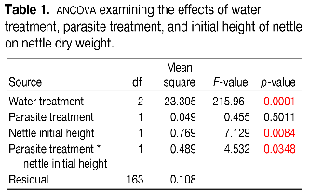
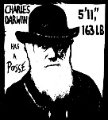
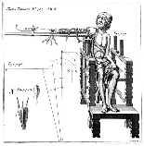

Title that hints at the underlying issue or question and is formatted in “sentence case”
Your name(s) here
Department of Biology, Swarthmore College, Swarthmore, Pennsylvania 19081
Maintain a good amount of space between your columns. Although you could squeeze them right up against each other, the poster’s aesthetics would suffer.
This means only the “t” in “title” gets capitalized.
This is a header. If you make the font size large, and then add bolding…there is no need to also apply underlining or italicization.
Make sure the edges of your columns are aligned with adjacent columns. Don’t trust your eyes: select the columns, then “Align” with the proper tool
Introduction
This is a Microsoft Powerpoint template that has column widths and font sizes optimized for printing a 36 x 56” poster—just replace the “tips” and “blah, blah, blah” repeat motifs with actual content, if you have it. Try to keep your total word count under 500 (yea, this suggestion applies to everyone, even you). More tips can be found at the companion site, “Advice on designing scientific posters,” at the Swarthmore College Biology Department web site.
This paragraph has “justified” margins, but be aware that simple left-justification (other paragraphs) is infinitely better if your font doesn’t “space” nicely when fully justified. Sometimes spacing difficulties can be fixed by manually inserting hyphens into longer words. (Powerpoint doesn’t automatically hyphenate, by the way.)
Your main text is easier to read if you use a “serif” font such as Palatino or Times (i.e., people have done experiments and found this to be the case). Use a non-serif font for your title and section headings.
Results
The overall layout for this section can, and probably should, be modified from this template, depending on the size and number of charts and photographs your specific experiment generated. You might want a single, large column to accommodate a large map, or perhaps you could arrange 6 figures in a circle in the center of the poster: do whatever it takes to make your results graphically clear. To see examples of how others have abused this template to fit their presentation needs, perform a Google search for “powerpoint template for scientific posters.”
Paragraph format is fine, but sometimes a simple list of “bullet” points can communicate results more effectively:
  9 out of 12 brainectomized rats survived
  Control rats completed maze faster, on average, than rats without brains (Fig. 3b) (t = 9.84, df = 21, p = 0.032)
If you can orient your label horizontally, viewers with fused neck musculature are more likely to read it.
Rats with brains navigate mazes faster
Conclusions
You can, of course, start your conclusions in column #3 if your results section is “data light.”
Conclusions should not be mere reminders of your results. Instead, you want to guide the reader through what you have concluded from the results. What is the broader significance? Would anyone be mildly surprised? Why should anyone care? This section should refer back, explicitly, to the “burning issue” mentioned in the introduction. If you didn’t mention a burning issue in the introduction, go back and fix that -- your poster should have made a good case for why this experiment was worthwhile.
Blah, blah, blah. Blah, blah, blah. Blah, blah, blah. Blah, blah, blah. Blah, blah, blah. Blah, blah, blah. Blah, blah, blah. Blah, blah, blah. Blah, blah, blah. Blah, blah, blah. Blah, blah, blah. Blah, blah, blah. Blah, blah, blah. Blah, blah, blah. Blah, blah, blah. Blah, blah, blah. Blah, blah, blah. Blah, blah, blah. Blah, blah, blah. Blah, blah, blah. Blah, blah, blah. Blah, blah, blah. Blah, blah, blah.
Blah, blah, blah. Blah, blah, blah. Blah, blah, blah. Blah, blah, blah. Blah, blah, blah. Blah, blah, blah. Blah, blah, blah. Blah, blah, blah.
Time (s)
Brainectomized
The first sentence of the first paragraph does not need to be indented.
Control (brain intact)
Maze difficulty index
Figure 4. Avoid keys that force readers to labor through complicated graphs: just label all the lines (or bars) and then delete the silly key altogether. The above figure would also be greatly improved if I had the ability to draw mini rats with and without brains. I would then put these little illustrations next to the lines they represent.
(a)
(b)
(c)
Be sure to separate figures from other figures by generous use of white space. When figures are too cramped, viewers get confused about which figures to read first and which legend goes with which figure.
Figures are preferred but tables are sometimes unavoidable. A table looks best when it is first composed within Microsoft Word, then “Inserted” as an “Object.” If you can add small drawings or icons to your tables, do so!
Materials and methods
Be brief, and opt for photographs or drawings whenever possible to illustrate organism, protocol, or experimental design. Viewers don’t actually want to read about the gruesome details, however fascinating you might find them.
Blah, blah, blah. Blah, blah, blah. Blah, blah, blah. Blah, blah, blah. Blah, blah, blah. Blah, blah, blah. Blah, blah, blah. Blah, blah, blah. Blah, blah, blah. Blah, blah, blah.
Blah, blah, blah. Blah, blah, blah. Blah, blah, blah. Blah, blah, blah. Blah, blah, blah. Blah, blah, blah. Blah, blah, blah. Blah, blah, blah. Blah, blah, blah. Blah, blah, blah.
Blah, blah, blah. Blah, blah, blah. Blah, blah, blah. Blah, blah, blah. Blah, blah, blah. Blah, blah, blah.
Remember: no period after journal name.
Literature cited
Bender, D.J., E.M Bayne, and R.M. Brigham. 1996. Lunar condition influences coyote (Canis latrans) howling. American Midland Naturalist 136:413-417.
Brooks, L.D. 1988. The evolution of recombination rates. Pages 87-105 in The Evolution of Sex, edited by R.E. Michod and B.R. Levin. Sinauer, Sunderland, MA.
Scott, E.C. 2005. Evolution vs. Creationism: an Introduction. University of California Press, Berkeley.
Society for the Study of Evolution. 2005. Statement on teaching evolution. < http://www.evolutionsociety.org/statements.html >. Accessed 2005 Aug 9.
Figure 3. Make sure legends have enough detail to fully explain to the viewer what the results are. Note that for posters it is good to put some “Materials and methods” information within the figure legends or onto the figures themselves—it allows the M&m section to be shorter, and gives viewer a sense of the experiment(s) even if they have skipped directly to figures. Don’t be tempted to reduce font size in figure legends, axes labels, etc.—your viewers are probably most interested in reading your figures and legends!
Often you will have some more text-based results between your figures. This text should explicitly guide the reader through the figures.
Blah, blah, blah (Figs. 3a,b). Blah, blah, blah. Blah, blah, blah. Blah, blah, blah. Blah, blah, blah. Blah, blah, blah. Blah, blah, blah. Blah, blah, blah.
Blah, blah, blah. Blah, blah, blah. Blah, blah, blah. Blah, blah, blah. Blah, blah, blah. Blah, blah, blah. Blah, blah, blah. Blah, blah, blah (Fig. 3c). Blah, blah, blah. Blah, blah, blah. Blah, blah, blah. Blah, blah, blah. Blah, blah, blah. Blah, blah, blah (data not shown).
Blah, blah, blah. Blah, blah, blah. Blah, blah, blah. Blah, blah, blah. Blah, blah, blah. Blah, blah, blah. Blah, blah, blah. Blah, blah, blah. Blah, blah, blah. Blah, blah, blah (God, personal communication).
This area is “white space” that adds tremendously to the readability of your poster. Resist the urge to fill it with text. Yea, this means you.
Acknowledgments
We thank I. Güor for laboratory assistance, Mary Juana for seeds, Herb Isside for applying the greenhouse stress treatment, and M.I. Menter for statistical advice and scintillating discussions. Funding for this project was provided by the Swarthmore College Department of Biology, a Merck summer stipend, and my mom. [Note that people’s titles are omitted.]
I sure wish I’d presented my theory with a poster before I wrote my book.
Abutting these last sections can save you a little space, and subtly indicates to viewers that the contents are not as important to read.
Put a figure here that explores a statistical result
Figure 1. Photograph or drawing of organism, chemical structure, or whatever. Don’t use graphics from the web (they look terrible when printed).
This is the gene of interest!
Same for this space.
Figure 5. You can use connector lines and arrows to visually guide viewers through your results. Making logical points this way is much, much better than making it in the text section. These lines can help viewers read your poster even when you’re not present.
For further information
Please contact email@swarthmore.edu. More information on this and related projects can be obtained at www.swarthmore… (give the URL for general laboratory web site). A link to an online, PDF-version of the poster is nice, too.
If you just must include a pretentious logo,
hide it down here. But don’t include a pretentious logo.
Use the space for something else.
Figure 2. Illustration of important piece of equipment, or perhaps a flow chart summarizing experimental design. Scanned, hand-drawn illustrations are usually preferable to computer-generated ones.
Blah, blah, blah. Blah, blah, blah. However, blah, blah, blah.

Slide 53
This is the Title of Your Presentation
Your Name, Title, Affiliation
Introduction and Objectives
Lay in your introduction
x
x
x
x
x
x
x
x
x
x
xxxxxxxxxxxxxxxxxxxxxxxxxxxxxxxxxxxxxxxxxxxxxxxxxxxx
Methodology
x
xxxxxxxxxxxxxxxxx
Study conclusions and ideas for new research
x
x
Population Studied
x
x
x
x
x
x
x
x
x
x
x
x
xx
x
x
xxxxxxxx
Discussions
xxxxx
Funding Source

Slide 54
RUBRIC: HYPOTHESIS AND/OR STATEMENT OF PROBLEM
For Maximal Impact/Points:
  A logical hypothesis/statement of problem was presented clearly
  Background information was relevant and summarized well. Connections to previous literature and broader issues were clear
  Goal of project was stated clearly and concisely; showed clear relevance beyond project

Slide 55
RUBRIC! RESULTS
Maximal Impact/Points from:
  Substantial amounts of high quality data were presented sufficient to address the hypothesis
  Presentation of data was clear, thorough, and logical

Slide 56
RUBRIC! CONCLUSION AND FUTURE WORK
Highest Impact/Score if:
  Reasonable conclusions were given and strongly supported with evidence
  Conclusions were compared to hypothesis and their relevance in a wider context was discussed

Slide 57
RUBRIC! POSTER BOARD PRESENTATION
Highest possible Impact/score when:
  All expected components are present, clearly laid out, and easy to follow in the absence of presenter
  The text is concise, legible, and consistently free of spelling or typographical errors; the background is unobtrusive
  The figures and tables are appropriate and consistently labeled correctly
  Photographs/tables/graphs improve understanding and enhance the visual appeal

Slide 58
RUBRIC! OVERALL PRESENTATION & HANDLING QUESTIONS
Highest Possible Impact/Score when:
  Demonstrates a very strong knowledge of the research project
  Speaks clearly, naturally and with enthusiasm; makes eye contact
  Comfortably uses visual aids to enhance presentation
  Answers difficult questions clearly and succinctly
  Presentation is consistently clear and logical

